Slide 1

Presented by Group 7 Akhil Sinai Bhangui (50419708) Pratik Malani (50416266) Mit Desai (50414541) Mustapha Wolly (50411890)
Robotics Programming with Force Control Presented at: The RIA Grinding, Deburring and Finishing Workshop St. Paul, Minnesota June 1996 By:Lester E. Godwin Vice President PushCorp, Inc

Slide 2
Force Control
Force control is a technique that arose to address a gap in the automated production industry and like any other control systems, robots are governed by feedback loops.
Most of the robot programming in the automated industry are accomplished by tedious, time consuming teach by show techniques.

Slide 3
Force Control
To enable a more dynamic manufacturing environmnent, off-line and lead-through programming were developed and they show promising applications in the streamlining and acceleration of robotic processes.
Both programming methods enable users to program robot motion in a simulated computer environment leaving the robot to continue in production.

Slide 4
Surface Finishing Applications
Surface finishing applications fall into two categories:
Part-In-Hand – the robot brings the part to be finished to the fixed surface finishing apparatus.
Tool-In-hand – the robot applies surface finishing tool to a fixed part

Slide 5
Surface Finishing Applications Part-In-Hand
Used when the part to be finished is relatively small (Gripper tooling)
Common in manufacturing because:
Robot load/unload operations can be combined with surface finish at a single work station
Processing parts can be done faster due to a larger surface area for the materials (belt, drives)
Fairly consistent compliance can be achieved with floor mounted open-loop compliance devices

Slide 6
Surface Finishing Applications Part-In-Hand
One disadvantage to tool-in-hand systems is that it is impossible to finish the surface part due to interference with gripper and insufficient robot dexterity.

Slide 7
Surface Finishing Applications Tool-in-Hand
Less common than Part-In-Hand in the manufacturing industry.
Used where part to be finished is very big/large.
In Tool-in-Hand, a compliance tool is mounted over the robot and part to be finished. The compliance tool can either be a passive or active device with disk/wheel type abrasive media.

Slide 8
Surface Finishing Applications Tool-in-Hand
Passive force devices – Used where precise force control is not necessary and are mostly used for flat contours and grinding operations
Active force devices – They are more ideal for tool-in-hand because these compensate for acceleration and gravitational effects so they can apply precise frame levels in any orientation.

Slide 9
Surface Finishing Applications Tool-In-hand
Active devices are able to tackle a wide range of finishing applications from poliishing to grinding on a variety of materials.
Active devices have a dedicated controller which have some unique advanced features which can ease robot programming.

Slide 10
Path Profiles
Motions for part-in-hand and tool-in-hand involve smooth sweeping movement.
To get a good finish, three important aspects of motion are considered important.
Surface Speed
Part Orientation
Approach Vector

Slide 11
Path Profiles Surface Speed
These are process variables that affect material removal rate in finishing operations. These variables are:
Aggressiveness of the Media
Force with which media was applied
Rate at which the media is fed
Speed at which media is moved over part surface.
Speed at which media is moved over part is the only one the robot has control over.

Slide 12
Path Profile Surface speed
The more aggresively a part is worked on a given pass, the faster the surface speed must be to prevent overheating the part surfacae and media.

Slide 13
Path Profile Part/Tool Orientation
To achieve consistent and uniform surface finish, orientation of part/tool is very important.
The overall surface appearance is directly affected by the concistency of location and shape of the area where the finishing mdeia contacts the part.
Irrespective of the programming technique used, maintaining a consistent contact pattern is the most important path programming consideration.

Slide 14
Path Profile Approach Vector
This is the means in which the part comes in first contact with the finishing media.
This is the Point where many surface finishing inconsistencies are found in the final part.
The number one rule applying to the approach vector is to come in gradually . These gradual and controlled motion serve to feather the finish at the edges.

Slide 15
Compliance
Compliance is, “the magnitude of displacement per unit of force”.
Compliance compensates for stiction and inertia effects on robots.
Compliance allows relatively stiff, position-controlled robots to apply forces more consistently over irregular and contoured surfaces because the material removal rate is highly dependent on the applied force.

Slide 16
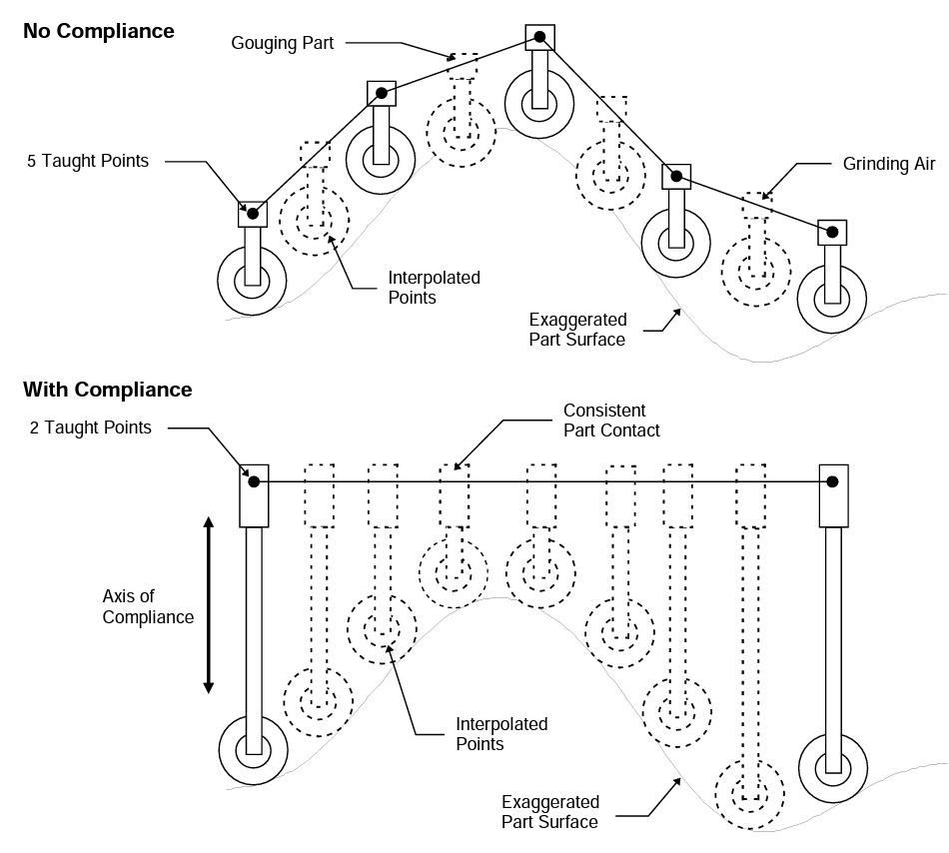
Effect of Compliance on Surface

Slide 17
Compliance
Compliance into a robot is called through-the-arm force control.
As the degree of compliance, or the applied force, is controlled by varying the torque applied by the servo motors at each link of the robot.
However, this has some disadvantages, it works well with compliant media in low-speed applications, but the performance deteriorates rapidly as speed increases.
This is due to large mass of robot arm and finite number of torque servo motors.

Slide 18
Types of Compliance
To counter this, Around-the-arm devices compliance techniques are used:
Spring Actuators.
Electro-magnetic Actuators.
Pneumatic Actuators

Slide 19
Types of Compliance Spring Actuators
It is the simplest type.
Forces are achieved via compression of spring.
Force applied by spring is directly proportional to the deflection.
A lot of dependence is on the applied force as the spring or media can compress due to the force. Thus, programming the robot path over the part is very critical.
Constant spring compression is maintained in order to maintain a constant force.

Slide 20
Types of Compliance Elecgtromagnetic Actuators
No dependence on applied force on position.
Constant force is applied over entire stroke.
Force applied can be quickly changed by varying the electrical current flowing through a solenoid.
Solenoids are quite heavy, and they require a great deal of electrical power to provide significant forces which is why these devices are normally floor mounted.

Slide 21
Types of Compliance Pneumatic Actuator
Constant force is applied over entire stroke.
Most common means of providing compliance in commercial surface finishing systems.
Available in both passive open-loop and active closed-loop systems.
Passive systems are generally used extensively in Part in Hand applications and controlled via manually operated or electrically controlled regulators.
The tooling is attached to the floor.

Slide 22
Active force devices build on passive technology by adding a force measurement transducer commonly referred to as a load cell.
These provide high precision compliance independent of spatial orientation, inertial, gravitational, and friction effects.
These devices are used in both Part-In-Hand and Tool-In-Hand applications.

Slide 23
Benefits of Real-Time Force Adjustment
Ability to easily and predictably change the effective compliance of a tool in real time.
Gives users unprecedented ability to continuously adapt compliant forces to optimize material removal and surface finish as the process is running.
The active force device continuously monitors and corrects the applied force.
The users can create and adjust their own complex compliance response dynamically in real-time.
Robot approach path will be less critical and higher speeds can be used.

Slide 24
Key Takeaways
When assembling an automated surface finishing cell, one should take time to consider programming issues before selecting equipment.
One should consider the relevant advantages and disadvantages in using a Part-In-Hand versus Tool-In-Hand configuration.
One should consider the time to manually teach robot paths versus purchasing more advanced simulation systems to generate robot paths off-line.
One should consider the costs and benefits of using passive versus active force devices.

Slide 25
THANK YOU
ANY QUESTIONS?

